Slide 1


Outliers smoothing in Sales FCST
2023-12-07

Slide 2
1.What are Outliers
2.How to handle Outliers
3.Benefits of Handling Outliers

Slide 3
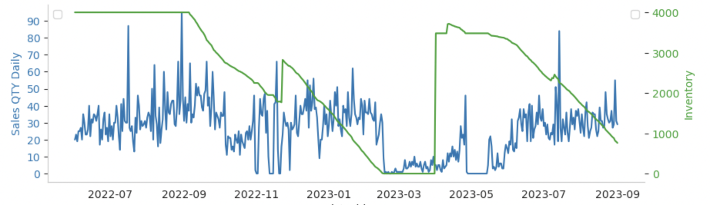
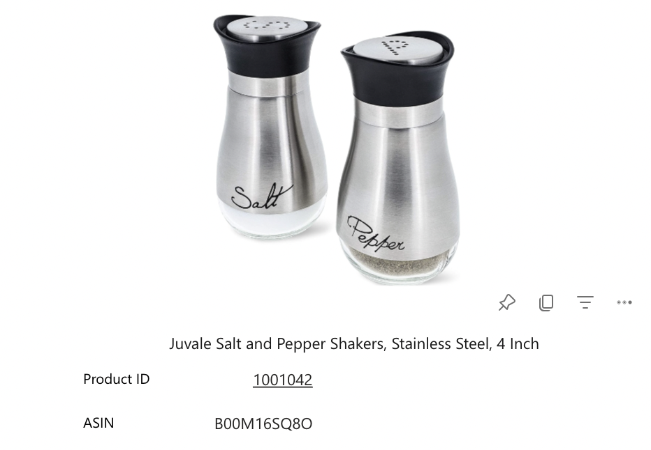
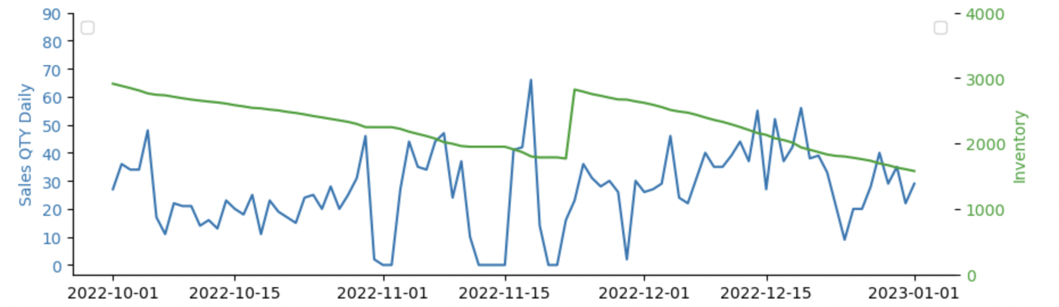
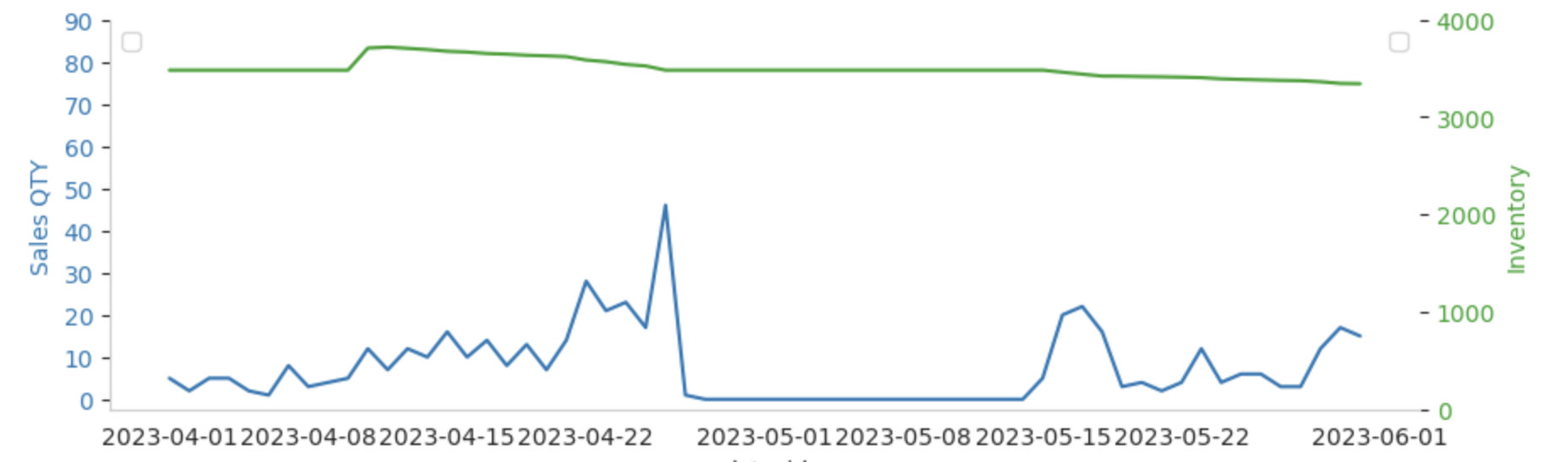
What are Outliers
High sales QTY: Abnormal Orders/SEM...
Low sales QTY: Adequate inventory, high frequency - intermittent zero sales
Low sales QTY: Sufficient inventory but no sales, due to UK account being shut down by the platform in May

Slide 4
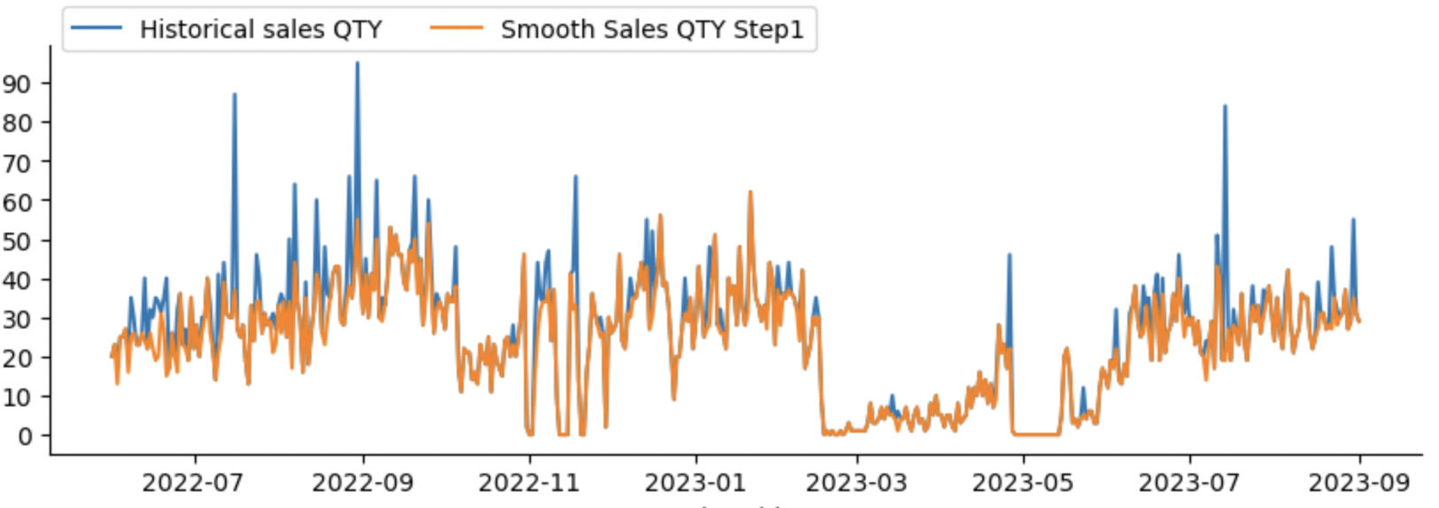
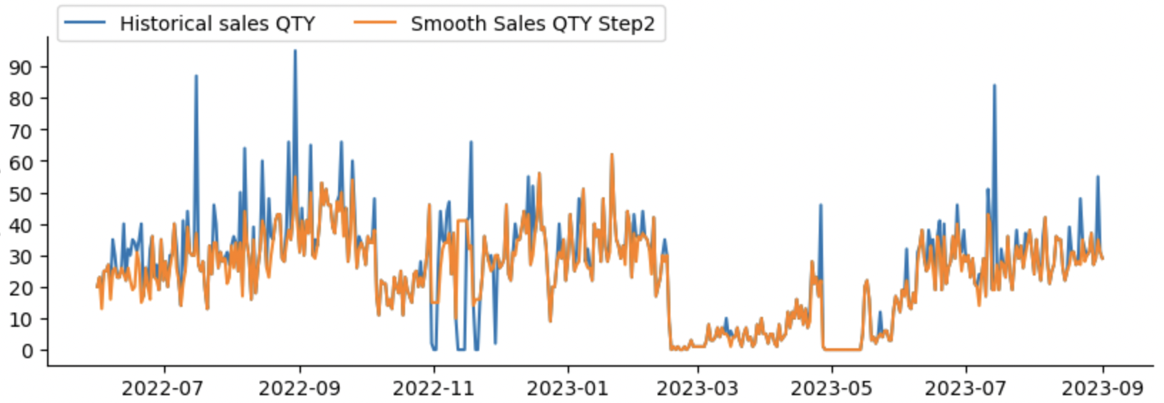
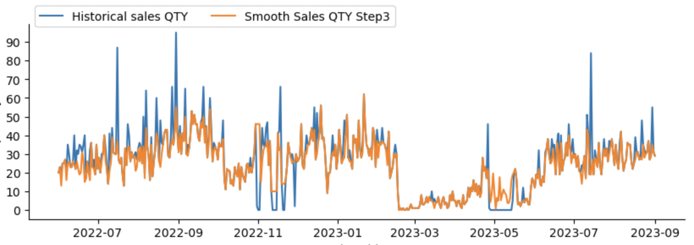
How to handle Outliers
1. Calculate the normal distribution range of the number of products per order for this product in the past 6 months
2. Check for anomalies in orders within the specified time range
3. Replace extremely high sales with the maximum sales within the normal distribution
When there are only a few days of abnormally low sales:
1.Smooth using the closest normal sales volume
When abnormal low sales occur for several weeks or more:
1. Calculate the sales distribution of the month before and after the anomaly (distribution indicators such as mean and variance)
2. Use virtual sales that conform to the same distribution to smooth out abnormally low sales

Slide 5
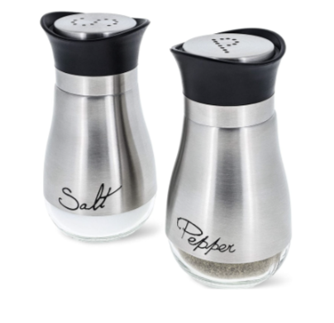
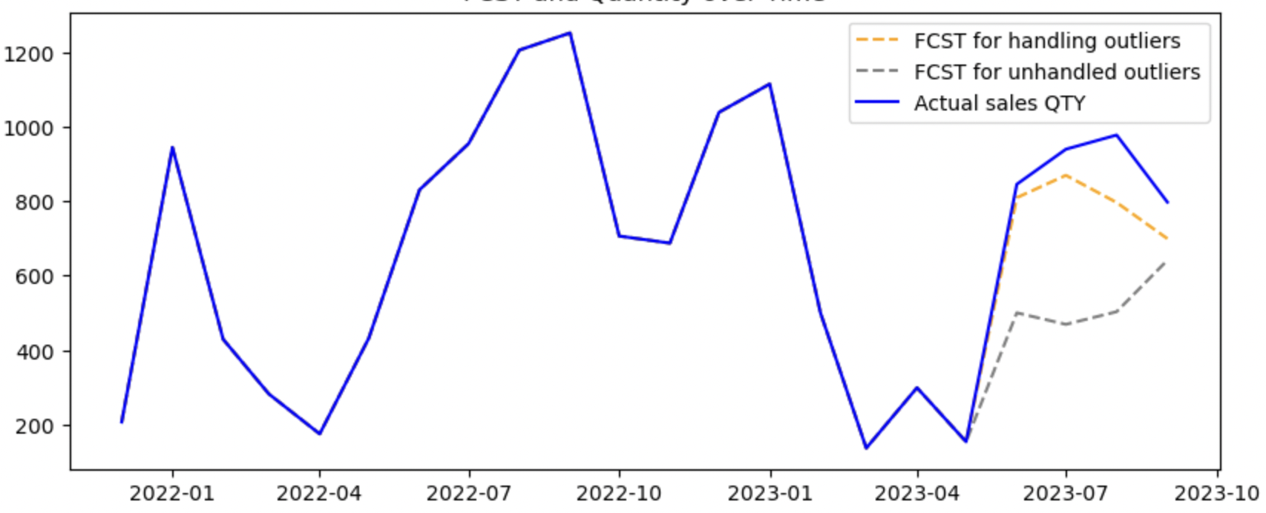
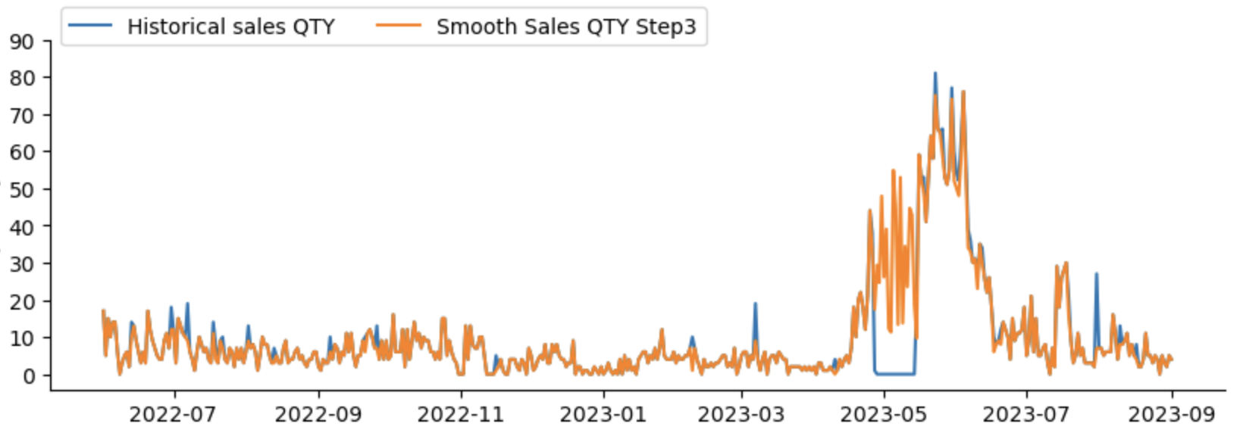
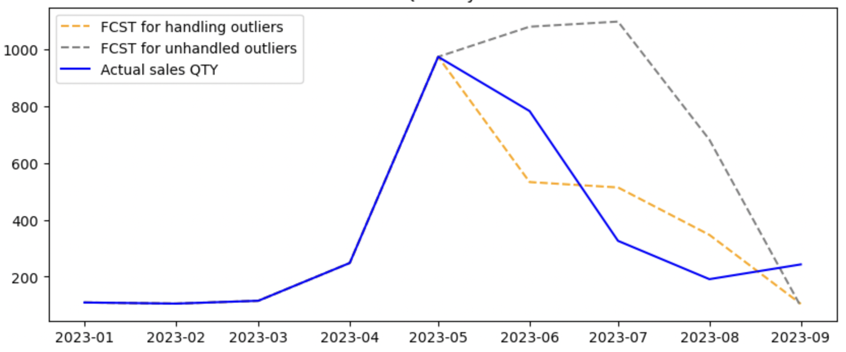

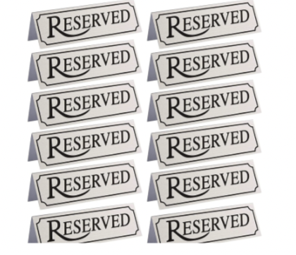
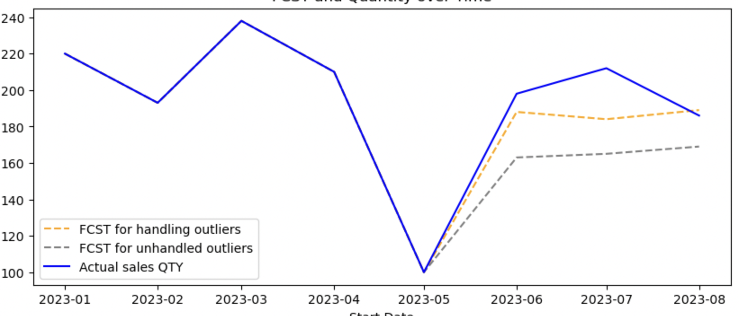
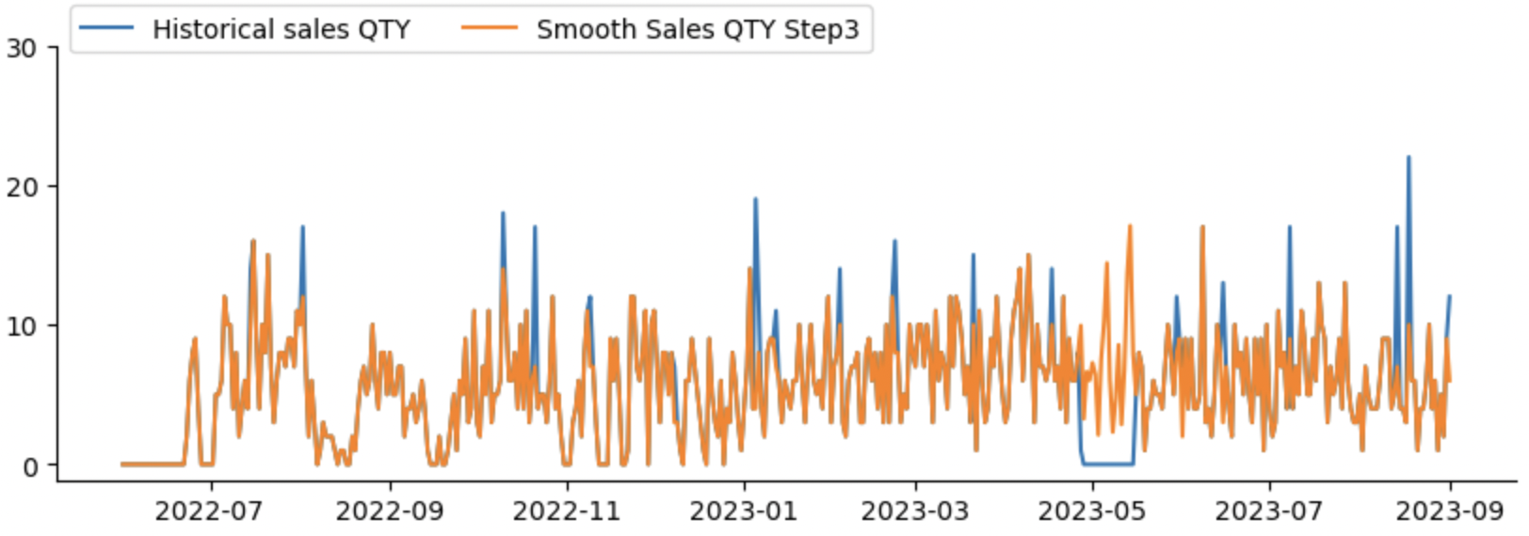
Benefits of Handling Outliers
AMZ_uk-B00M16SQ8O
Forecasting
AMZ_uk-B072888GQ9
Forecasting
AMZ_uk-B00M16SQ8O
Forecasting

